Slide 1
Intro to Cloud Computing CS4037 (BCS-6A) Lecture 05
Danyal Farhat
FAST School of Computing, NUCES Lahore
14 February, 2023

Slide 2
Module 3: AWS Global Infrastructure Overview
AWS Academy Cloud Foundations

Slide 3
Module overview
Topics
AWS Global Infrastructure
AWS service and service category overview

Slide 4
Module objectives
After completing this module, you should be able to:
Identify the difference between AWS Regions, Availability Zones, and edge locations
Identify AWS service and service categories

Slide 5
Section 1: AWS Global Infrastructure
Module 3: AWS Global Infrastructure Overview

Slide 6
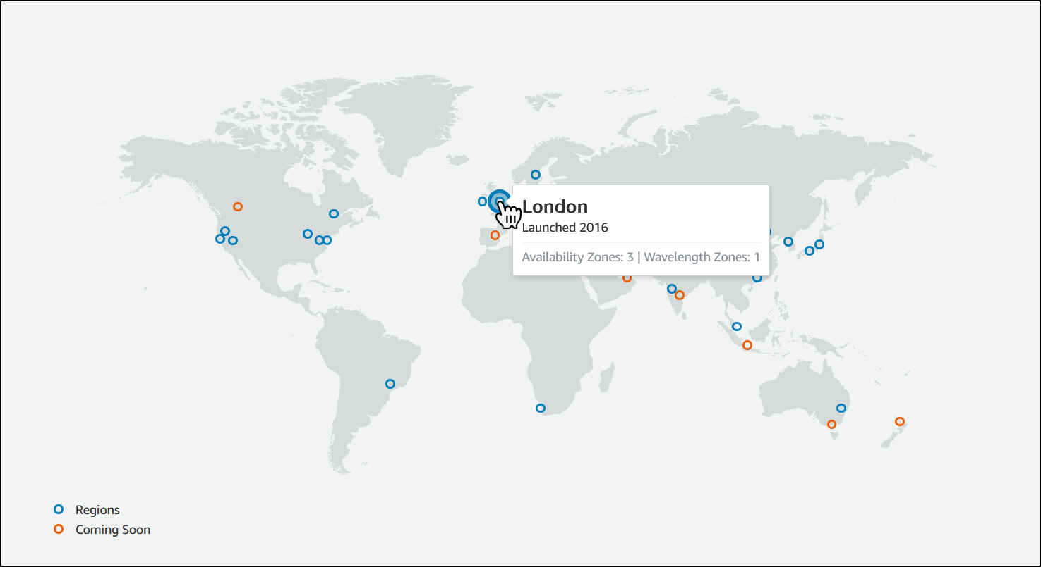
AWS Global Infrastructure
The AWS Global Infrastructure is designed and built to deliver a flexible, reliable, scalable, and secure cloud computing environment with high-quality global network performance.
AWS continually updates its global infrastructure footprint.

Slide 7
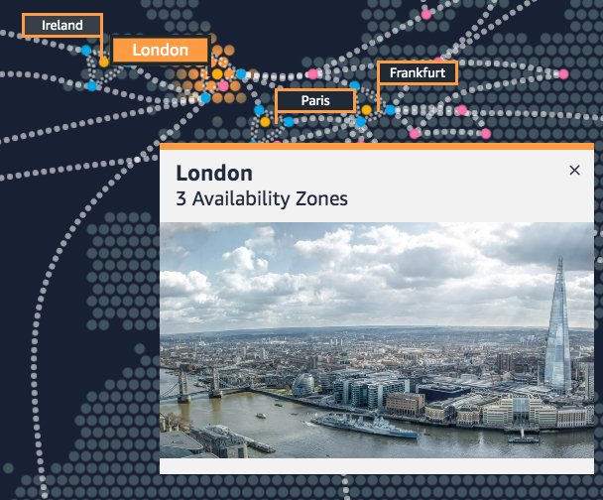
AWS Regions
An AWS Region is a geographical area.
Data replication across Regions is controlled by you.
Communication between Regions uses AWS backbone network infrastructure.
Each Region provides full redundancy and connectivity to the network.
A Region typically consists of one or more Availability Zones.
AWS China and AWS GovCloud (US) Regions
Example: London Region
Notes:
The AWS Cloud infrastructure is built around Regions. AWS has 22 Regions worldwide. An AWS Region is a physical geographical location with one or more Availability Zones. Availability Zones in turn consist of one or more data centers.
To achieve fault tolerance and stability, Regions are isolated from one another. Resources in one Region are not automatically replicated to other Regions. When you store data in a specific Region, it is not replicated outside that Region.
It is your responsibility to replicate data across Regions, if your business needs require it.
Some Regions have restricted access. An Amazon AWS (China) account provides access to the Beijing and Ningxia Regions only. To learn more about AWS in China, see: https://www.amazonaws.cn/en/about-aws/china/. The isolated AWS GovCloud (US) Region is designed to allow US government agencies and customers to move sensitive workloads into the cloud by addressing their specific regulatory and compliance requirements.

Slide 8
Selecting a Region
Data governance, legal requirements
Proximity to customers (latency)
Determine the right Region for your services, applications, and data based on these factors
Services available within the Region
Costs (vary by Region)

Slide 9



Availability Zones
Each Region has multiple Availability Zones.
Each Availability Zone is a fully isolated partition of the AWS infrastructure.
Availability Zones consist of discrete data centers
They are designed for fault isolation
They are interconnected with other Availability Zones by using high-speed private networking
You choose your Availability Zones.
AWS recommends replicating data and resources across Availability Zones for resiliency.
AWS Cloud
Region eu-west-1
Availability Zone eu-west-1a
Data center
Data center
Data center
Availability Zone eu-west-1b
Availability Zone eu-west-1c
Notes:
Each AWS Region has multiple, isolated locations that are known as Availability Zones.
Each Availability Zone provides the ability to operate applications and databases that are more highly available, fault-tolerant, and scalable than would be possible with a single data center. Each Availability Zone can include multiple data centers (typically three), and at full-scale, they can include hundreds of thousands of servers. They are fully isolated partitions of the AWS Global Infrastructure. Availability Zones have their own power infrastructure, and they are physically separated by many kilometers from other Availability Zones—though all Availability Zones are within 100 km of each other.
All Availability Zones are interconnected with high-bandwidth, low-latency networking over fully redundant, dedicated fiber that provides high-throughput between Availability Zones. The network accomplishes synchronous replication between Availability Zones.
Availability Zones help build highly available applications. When an application is partitioned across Availability Zones, companies are better isolated and protected from issues such as lightning, tornadoes, earthquakes, and more.
You are responsible for selecting the Availability Zones where your systems will reside. Systems can span multiple Availability Zones. AWS recommends replicating across Availability Zones for resiliency. You should design your systems to survive the temporary or prolonged failure of an Availability Zone if a disaster occurs.

Slide 10

AWS data centers
AWS data centers are designed for security.
Data centers are where the data resides and data processing occurs.
Each data center has redundant power, networking, and connectivity, and is housed in a separate facility.
A data center typically has 50,000 to 80,000 physical servers.
NUCES LHR as Single Availability zone

Slide 11
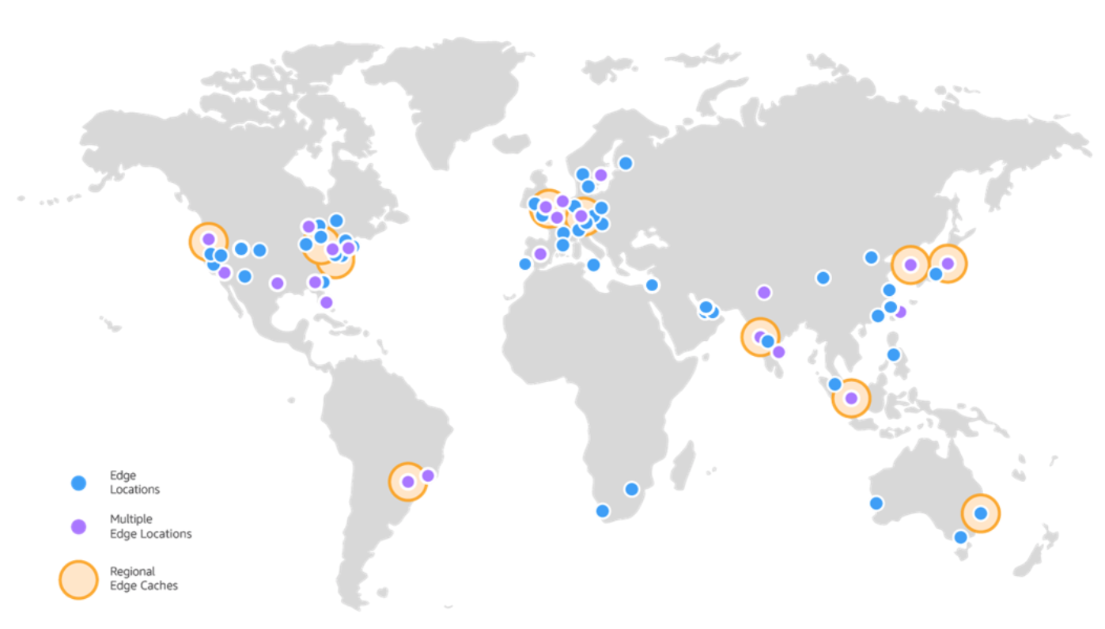
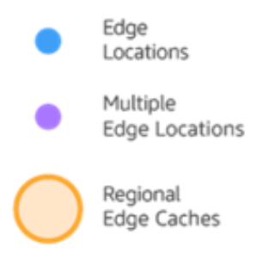
Points of Presence
AWS provides a global network of Points of Presence locations
Consists of edge locations and a much smaller number of Regional edge caches
Used with Amazon CloudFront
A global Content Delivery Network (CDN), that delivers content to end users with reduced latency
Regional edge caches used for content with infrequent access.
Notes:
Amazon CloudFront is a content delivery network (CDN) used to distribute content to end users to reduce latency. Amazon Route 53 is a Domain Name System (DNS) service. Requests going to either one of these services will be routed to the nearest edge location automatically in order to lower latency.
AWS Points of Presence are located in most of the major cities around the world. By continuously measuring internet connectivity, performance and computing to find the best way to route requests, the Points of Presence deliver a better near real-time user experience. They are used by many AWS services, including Amazon CloudFront, Amazon Route 53, AWS Shield, and AWS Web Application Firewall (AWS WAF) services.
Regional edge caches are used by default with Amazon CloudFront. Regional edge caches are used when you have content that is not accessed frequently enough to remain in an edge location. Regional edge caches absorb this content and provide an alternative to that content having to be fetched from the origin server.

Slide 12




AWS infrastructure features
Elasticity and scalability
Elastic infrastructure; dynamic adaption of capacity
Scalable infrastructure; adapts to accommodate growth
Fault-tolerance
Continues operating properly in the presence of a failure
Built-in redundancy of components
High availability
High level of operational performance
Minimized downtime
No human intervention
Physically distinct
Backup generators
Data center
Data center
Data center
Data center
Data center
Data center
Data center
Data center
Availability Zone
Availability Zone
Network connectivity
Data center
Data center
Data center
Data center
Availability Zone
Uninterruptible power supply
Cooling equipment
AWS Region

Slide 13

Key takeaways
The AWS Global Infrastructure consists of Regions and Availability Zones.
Your choice of a Region is typically based on compliance requirements or to reduce latency.
Each Availability Zone is physically separate from other Availability Zones and has redundant power, networking, and connectivity.
Edge locations, and Regional edge caches improve performance by caching content closer to users.

Slide 14
Section 2: AWS services and service category overview
Module 3: AWS Global Infrastructure Overview

Slide 15


AWS foundational services
Applications
Virtual desktops
Collaboration and sharing
Databases
Analytics
Application services
Deployment and management
Mobile Services
Cluster computing
Relational
Queuing
Containers
Identity
Platform Services
Real-time
Orchestration
DevOps tools
Sync
NoSQL
Data warehouse
App Streaming
Resource templates
Mobile Analytics
Transcoding
Email
Usage tracking
Caching
Data workflows
Notifications
Search
Monitoring and logs
Compute (virtual, automatic scaling, and load balancing)
Networking
Storage (object, block, and archive)
Foundation
Services
Infrastructure
Regions
Availability Zones
Edge locations

Slide 16






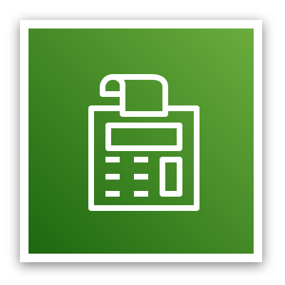

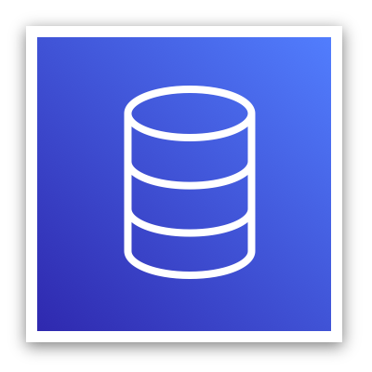

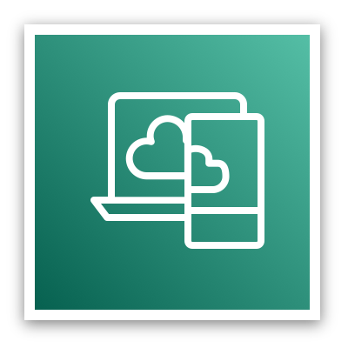



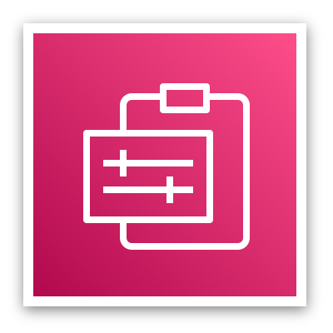



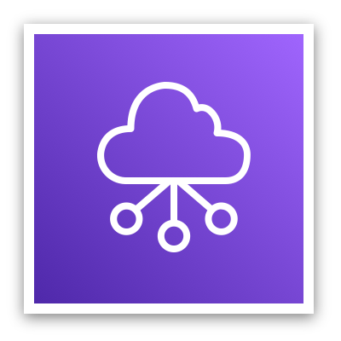



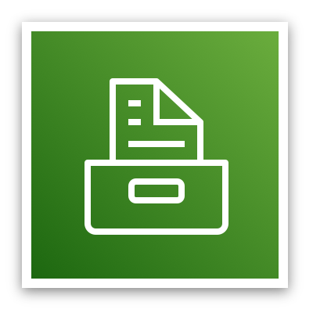
AWS categories of services
Analytics
Application
Integration
AR and VR
Blockchain
Business Applications
Compute
Cost Management
Customer Engagement
Database
Developer Tools
End User
Computing
Game Tech
Internet of Things
Machine Learning
Management and Governance
Media Services
Migration and
Transfer
Mobile
Networking and
Content Delivery
Robotics
Satellite
Security, Identity, and Compliance
Storage

Slide 17

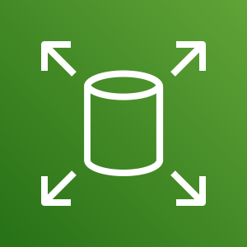
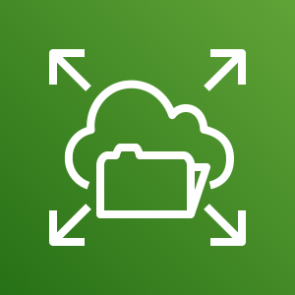

Storage service category
AWS storage services
Amazon Simple Storage Service (Amazon S3)
Amazon Elastic Block Store (Amazon EBS)
Amazon Elastic File System (Amazon EFS)
Photo from https://www.pexels.com/photo/black-and-grey-device-159282/
Amazon Simple Storage Service Glacier

Slide 18







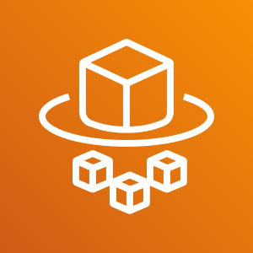
Compute service category
AWS Compute services
Amazon EC2
Amazon EC2 Auto Scaling
Amazon Elastic Container Service (Amazon ECS)
Amazon EC2 Container Registry
Photo from https://www.pexels.com/photo/technology-computer-lines-board-50711/
AWS Elastic Beanstalk
AWS Lambda
Amazon Elastic Kubernetes Service (Amazon EKS)
AWS Fargate

Slide 19



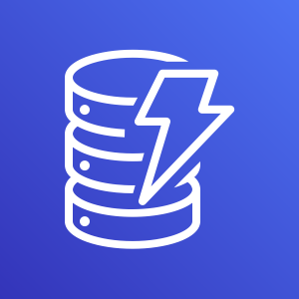
Database service category
AWS Database services
Amazon Relational Database Service
Amazon Aurora
Amazon Redshift
Amazon DynamoDB
Photo from https://aws.amazon.com/compliance/data-center/data-centers/

Slide 20







Networking and content delivery service category
AWS networking and content delivery services
Amazon VPC
Elastic Load Balancing
Amazon CloudFront
AWS Transit
Gateway
Amazon Route 53
AWS Direct Connect
AWS VPN
Photo by Umberto on Unsplash

Slide 21
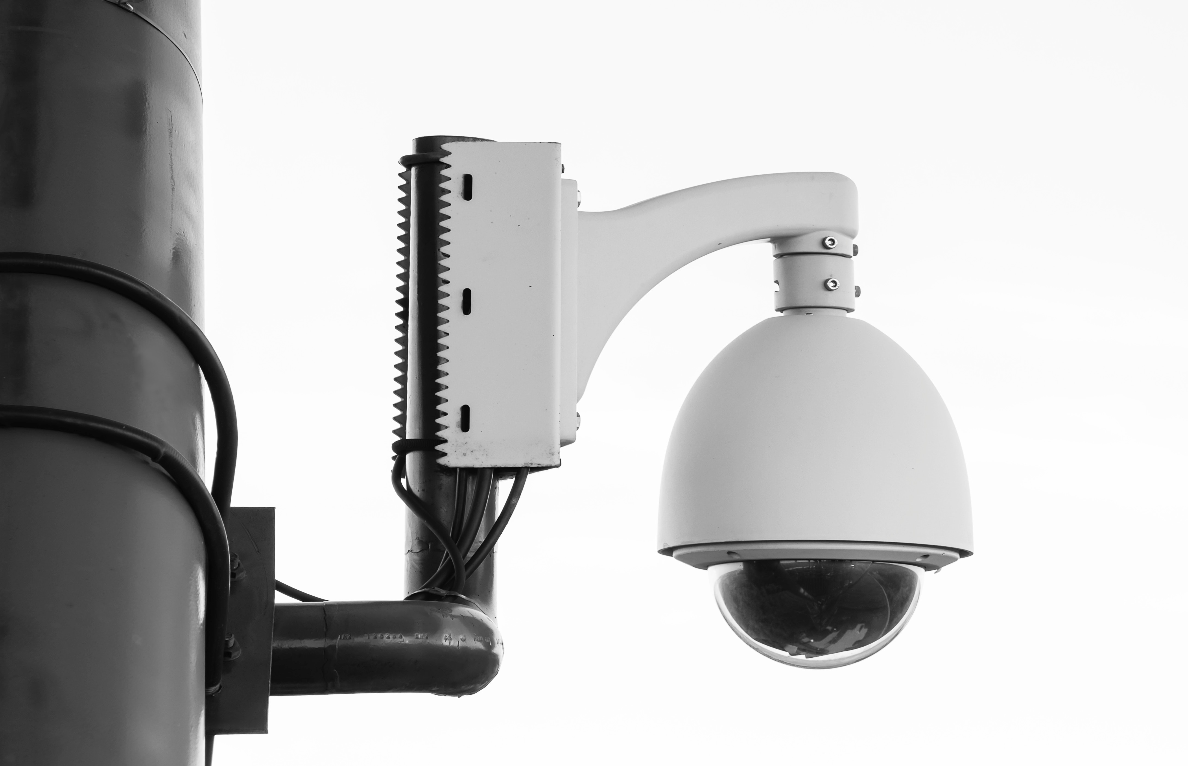

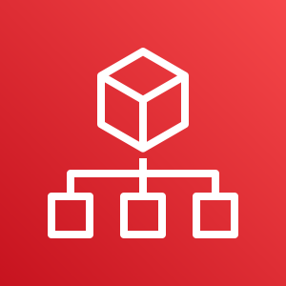

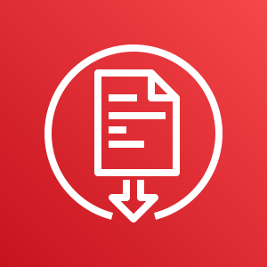


Security, identity, and compliance service category
AWS security, identity, and compliance services
AWS Identity and Access Management (IAM)
AWS Organizations
Amazon Cognito
Photo by Paweł Czerwiński on Unsplash
AWS Artifact
AWS Key
Management Service
AWS Shield

Slide 22

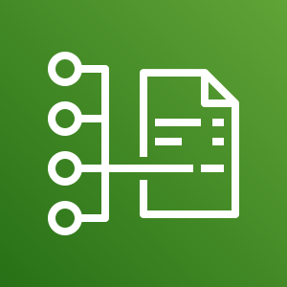


AWS cost management service category
AWS cost management services
AWS Cost and
Usage Report
AWS Budgets
AWS Cost
Explorer
Photo by Alexander Mils on Unsplash

Slide 23








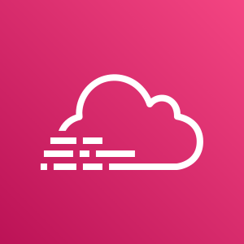
Management and governance service category
AWS management and
governance services
AWS Management Console
AWS Config
Amazon CloudWatch
AWS Auto Scaling
Photo by Marta Branco from Pexels
AWS Command
Line Interface
AWS Trusted
Advisor
AWS Well- Architected Tool
AWS
CloudTrail

Slide 24
Basic Questions
Question #1: Under which service category does the IAM service appear?
Answer: Security, Identity, & Compliance.
Question #2: Under which service category does the Amazon VPC service appear?
Answer: Networking & Content Delivery
Question #3: Does the VPC exist at the level of the Region or the level of the Availability Zone?
Answer: VPCs exist at the Region level.
Question #4: Which of the following services are global instead of Regional? Check Amazon EC2, IAM, Lambda, and Route 53.
Answer: IAM and Route 53 are global. Amazon EC2 and Lambda are Regional.

Slide 25
Module wrap-up
Module 3: AWS Global Infrastructure Overview

Slide 26
Module summary
In summary, in this module you learned how to:
Identify the difference between AWS Regions, Availability Zones, and edge locations
Identify AWS service and service categories

Slide 27
Additional resources
AWS Global Infrastructure: https://aws.amazon.com/about-aws/global-infrastructure/
AWS Regional Services List: https://aws.amazon.com/about-aws/global-infrastructure/regional-product-services/
AWS Cloud Products: https://aws.amazon.com/products/

Slide 28
Thank you
All trademarks are the property of their owners.

